Slide 1
FINAL PROJECT

Slide 2

GOAL
Improve reporting and compliance rates for San Francisco’s Existing Commercial Buildings Energy Performance Ordinance.

Slide 3

COMPLIANCE
60%

Slide 4
WHY?
DATA ACCESS = HARD

Slide 5
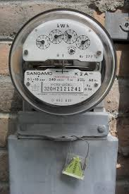

Slide 6
SOLUTION

Slide 7
WHY?
REDUCE METER THRESHOLD
INCREASE DATA ACCESS

Slide 8
WHY?
INCREASED DATA ACCESS
=
MORE BUILDINGS LIKELY TO REPORT

Slide 9
WHY?
MORE BUILDINGS = TRANSPARENCY

Slide 10
WHY?
TRANSPARENCY INFORMS ACTION

Slide 11
SOLUTION
WHOLE-BUILDING ENERGY DATA DISCLOSURE BY UTILITIES AT A REDUCED METER THRESHOLD

Slide 12

DESCRIPTIVE QUESTIONS
METER THRESHOLD ANALYSIS
CHECKPOINTS
Total kWh
Total SqFt
Total GHGs
MAPPING METERS PER BUILDING

Slide 13
MACHINE LEARNING QUESTION
WHAT IS THE LIKELIHOOD THAT A PARTICULAR BUILDING WILL COMPLY WITH THE ORDINANCE?

Slide 14

MACHINE LEARNING PROBLEM

Slide 15
DATA SOURCES
PG&E electric meter use
SF Department of the Environment Ordinance data
Energy Star Portfolio Manager
Tax Assessor data
Various GIS layers from SF Planning Department

